Slide 1
Segmentation of Time Series Data from Aircraft Sensors
Shubham Kashyapi (MM16B027)
(Advisor: Prof. Raghunathan Rengaswamy)

Slide 2
Introduction
Collaboration between Dassault Aviation and IIT Madras
Monitoring of aircraft systems using operational sensor data
Identifying different modes of operation from the data
Developing models to characterize the normal flight dynamics
Detecting anomalous using these models
Predictive and prognostic maintenance of the system

Slide 3
Problem Statement
Dataset Description: During a flight, time series data collected from multiple sensors. (Pressure, Temperature, Altitude)
Segmentation of Time Series:
Dividing a time series into segments corresponding to different operating modes
Identifying steady-state, trends and turbulent regimes
Ground truth is not known since the data is unlabelled
Detecting relations between different variables

Slide 4
Literature Survey
Warren Liao, T. (2005)¹. Clustering of time series data - a survey.
Similarity between clustering of unordered data and segmentation of time series data
Use of hierarchical (top-down and bottom-up methods) in segmentation
Dash, S., et al. (2004)². A novel interval-halving framework for automated identification of process trends.
Top-down approach for dividing a time series into primitive segments
Case studies on simulated data and real industrial data
Antunes, M., et al. (2019)³. Al and s methods: Two extensions for l-method.
Technique for tuning hyperparameters of the Interval-Halving algorithm
Rezatofighi, H., et al. (2019)⁴. Generalized intersection over union: A metric and a loss for bounding box regression.
Metric for the segmentation similarity between two time series

Slide 5
Interval-Halving Algorithm
Recursive-Split (Data[start ... end] : time series)
Hyperparameters- M : (Minimum Window Length), Noise Error
Recursive-Split (start, end)
Fit a degree 0 polynomial. Perform f-test using Noise Error. Good fit → Steady-state (Terminate)
Poor fit
Fit a degree 1 polynomial. Perform f-test using Noise Error. Good fit → Trend (Terminate)
Poor fit
Fit a degree 2 polynomial. Perform f-test using Noise Error. Good fit → Trend (Terminate)
Split the interval into two.
Recursive-Splitting (start, mid)
Recursive-Splitting (mid+1, end)
Split
If IntervalLength < 2*M
(no further splitting) →
Noisy (Terminate)
Poor fit

Slide 6
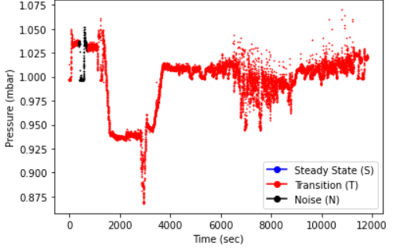
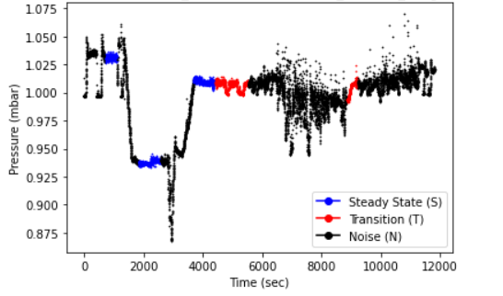
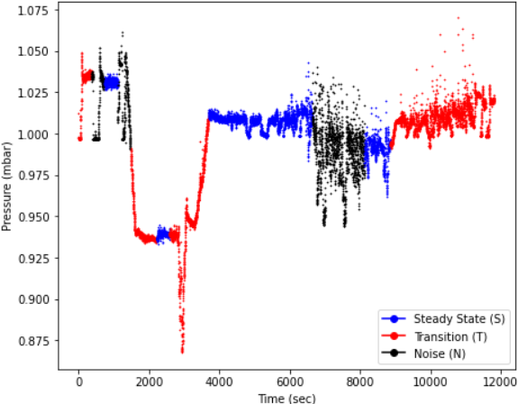
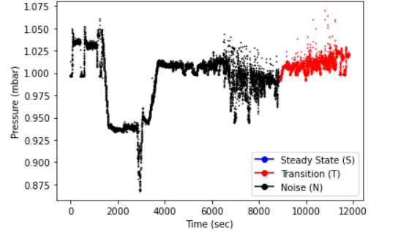
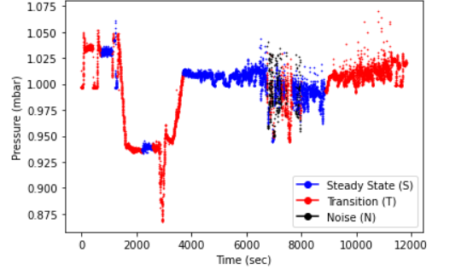
Hyperparameter Tuning
High Noise Error
Low Noise Error
Case No 37 (PSPCKOU)
Using tuned hyperparameters
Large Window
Small Window

Slide 7
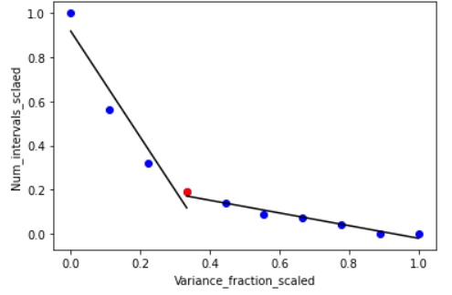
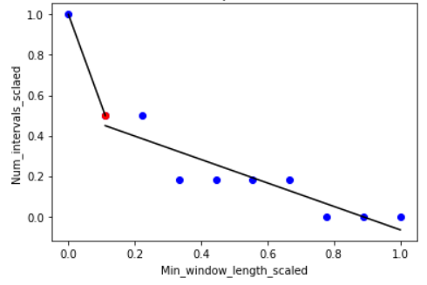
Hyperparameter Tuning
Choosing possible values of hyperparameters
Noise Error: Fractions*Variance(time series)
Minimum Window Length: Fractions*Length(time series)
Determining the optimal values
Keep one hyperparameter fixed, vary the second one
Obtain number of segments returned by the algorithm
Get an elbow curve: Number of segments vs Hyperparameter
For every point in the elbow curve³:
Fit two regression lines- through points to the left, points to the right
For the elbow point, the angle between these lines should be closest to 90⁰
Elbow Curves: Case No 37 (PSPCKOU)

Slide 8
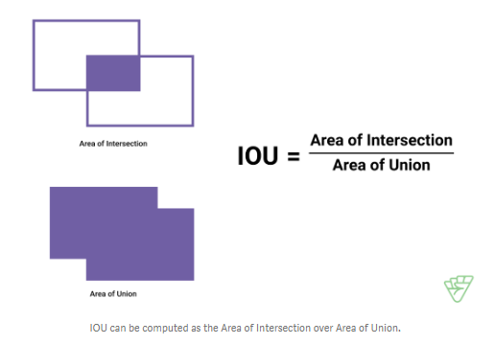
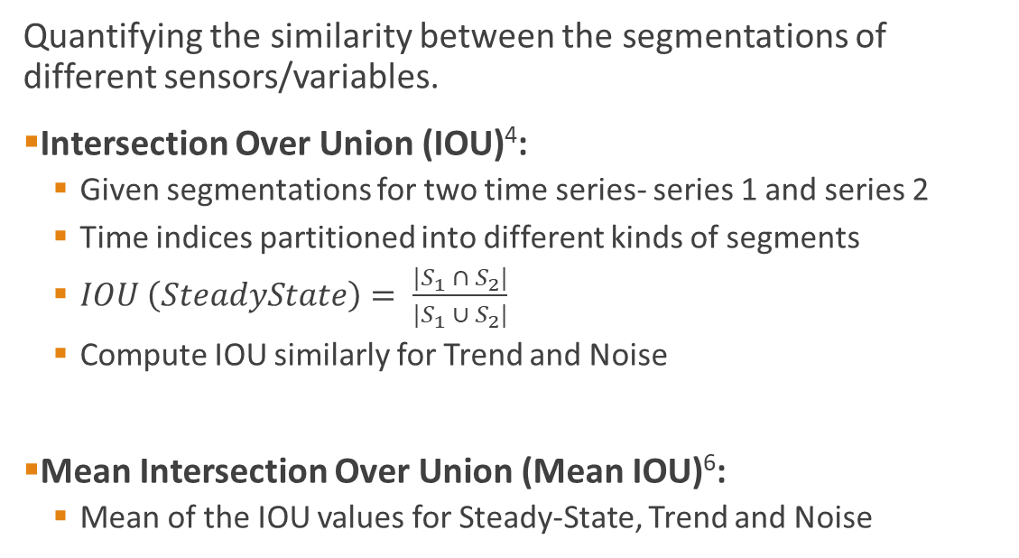
Similarity Metric for Segmentation
Quantifying the similarity between the segmentations of different sensors/variables.
Intersection Over Union (IOU)⁴:
Given segmentations for two time series- series 1 and series 2
Time indices partitioned into different kinds of segments
$IOU \left(SteadyState\right)= \frac{|S_{1} ∩ S_{2}|}{|S_{1} ∪ S_{2}|}$
Compute IOU similarly for Trend and Noise
Mean Intersection Over Union (Mean IOU)⁶:
Mean of the IOU values for Steady-State, Trend and Noise
Source: [5]
[5]: Tan, I. (). URL https://medium.com/supahands-techblog/measuring-labelling-quality-with-iou-and-f1-score-1717e29e492f

Slide 9
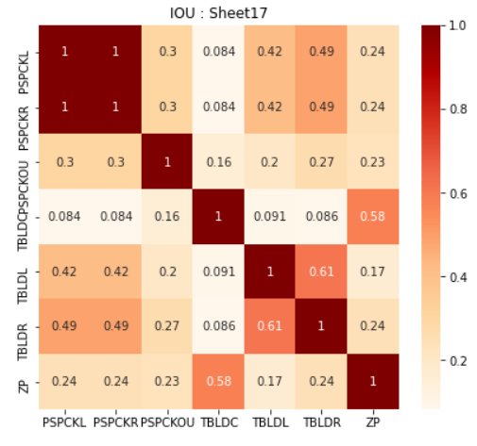
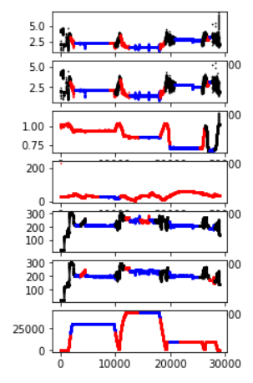
Similarity between Variables
Pairwise Mean IOU (Case no. 17 - BLEED Dataset)
Plots of all variables (Case no. 17 - BLEED Dataset)
[PSPCKL, PSPCKR, PSPCKOU, TBLDC, TBLDL, TBLDR, ZP]

Slide 10
Detection of Lags
Possibility of lags between certain pairs of variables
Algorithm for lag detection:
Obtain the segmentation for both the time series separately, compute Mean IOU.
Choose a set of likely shifts.
For each shift
Compute the Mean IOU for the overlapping time indices
Shift corresponding to the maximum value of Mean IOU is the optimal shift
Result:
For most pairs of time series, increase in Mean IOU is very small
For a few pairs, we get a large increase (~0.6 to ~0.9) in the Mean IOU

Slide 11
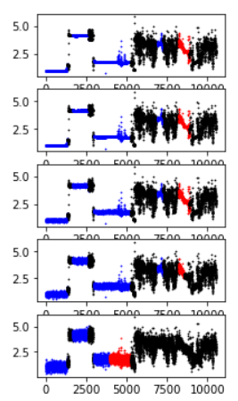
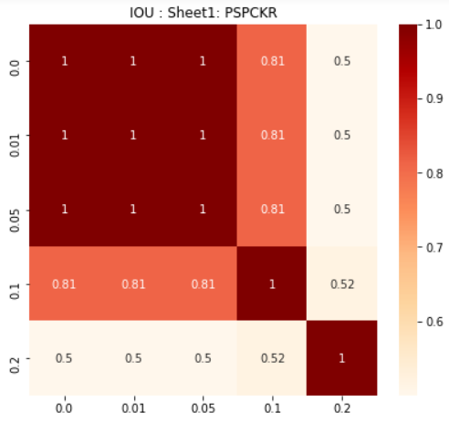
Robustness to Noise
Add Gaussian noise with different variances to obtain multiple time series
Obtain the segmentation for each time series. Compute pair-wise Mean IOU
Variance Fraction 0.0, 0.01, 0.05, 0.1, 0.2

Slide 12
Conclusions & Future Work
Identification of operating regimes in a time series
Computing the optimal hyperparameters of this algorithm using elbow curves
Metric (Mean Intersection Over Union) for computing the segmentation overlap
Computing the similarity between variables using this metric.
Checking for the existence of lags between the variables of a given flight.
Testing the segmentation algorithm for robustness
Future Work:
Exploring another approach for computing segmentation using simplicial complexes⁷
Comparison of results from the two approaches

Slide 13
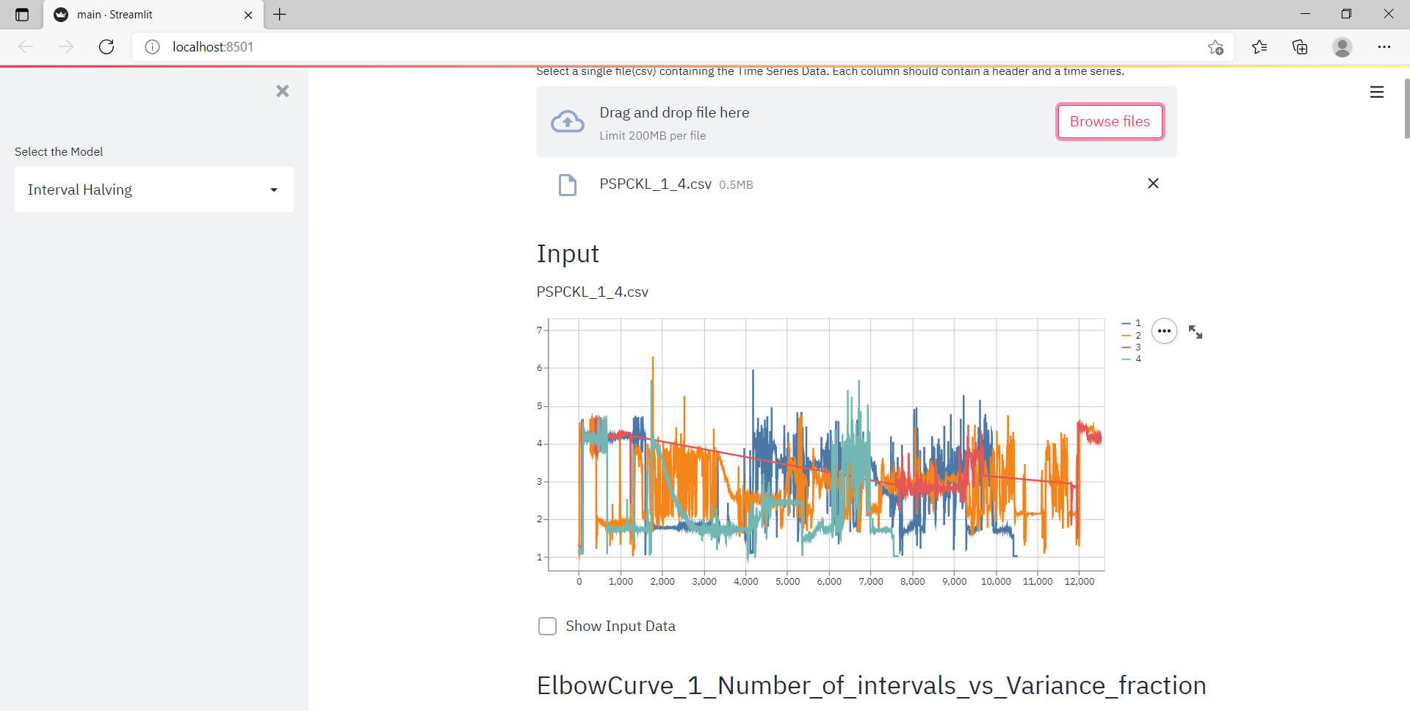
Conclusions & Future Work
User Interface (UI)
Better visualization of results and further experimentation
Submission of technical report to Dassault Aviation
Screenshot of UI

Slide 14
References
[1] Warren Liao, T. (2005). Clustering of time series data - a survey. Pattern Recognition, 38(11), 1857–1874. ISSN 00313203, doi:10.1016/j.patcog.2005.01.025.
[2] Dash, S., M. R. Maurya, V. Venkatasubramanian, and R. Rengaswamy (2004). A novel interval-halving framework for automated identification of process trends. AIChE Journal, 50(1), 149–162, doi:https://doi.org/10.1002/aic.10014.
[3] Antunes, M., H. Aguiar, and D. Gomes (2019). Al and s methods: Two extensions for l-method. Institute of Electrical and Electronics Engineers Inc. ISBN 9781728128887, doi:10.1109/FiCloud.2019.00061
[4] Rezatofighi, H., N. Tsoi, J. Gwak, A. Sadeghian, I. Reid, and S. Savarese (2019). Generalized intersection over union: A metric and a loss for bounding box regression. volume 2019-June. IEEE Computer Society. ISBN 9781728132938. ISSN 10636919, doi:10.1109/CVPR.2019.00075.
[5] Tan, I. (). URL https://medium.com/supahands-techblog/measuring-labelling-quality-with-iou-and-f1-score-1717e29e492f
[6] Tensorflow (). URL https://www.tensorflow.org/api_docs/python/tf/keras/metrics/MeanIoU
[7] Chutani, M., N. Rao, N. Nirmal Thyagu, and N. Gupte (2020). Characterizing the complexity of time series networks of dynamical systems: A simplicial approach. Chaos: An Interdisciplinary Journal of Nonlinear Science, 30(1), 013109, doi:10.1063/1.5100362.

